Slide 1

InsightAI Dashboard
Innovative web application for interactive data visualization and analysis with Artificial Intelligence.
Group:
Sohaib Ahmed 21L-5635
Muhammad Hamza Khan 21L-5654
Muhammad Hassan Khalid 21L-5692
Supervisor:
Muhammad Zeeshan Nazar

Slide 2
Outline
1
Problem Statement
2
Project Scope
3
Goals Achieved
4
Related Applications
5
System Overview
6
Important Requirements
7
Graphical User Interface
8
Constraints and Limitations
9
Future Goals
10
Timeline
11
Conclusion: Transforming Data Analysis

Slide 3

Problem Statement
Complex Applications
Technical Barriers
Costly Solutions
Limited flexibility hinders data exploration.
Non-technical users struggle with analysis tools.
Extracting meaningful insights is challenging.

Slide 4

Project Scope

Slide 5
In-Scope
1
Data Ingestion
2
Analysis Tools
3
Visualization
Support for structured and unstructured data formats.
AI-powered and manual data manipulation options.
Creation of interactive charts, graphs, and diagrams.
4
Reporting
5
Diagram Creation
6
User-Friendly Interface
Generation of custom reports and actionable insights.
Flowcharts, ER diagrams, and more.
Responsive design for all expertise levels
7
Download Options
8
Data Cleaning Tools
9
Custom Dashboards
Export visuals and reports in preferred formats.
Preprocessing options for dataset optimization.
Create and export visualizations easily.

Slide 6
Out-of-Scope
1
Real-Time Data Connections
2
Mobile Development
3
Collaborative Editing
No mobile app versions planned.
No simultaneous multi-user editing.
No live data streaming support.
4
Advanced AI Features
5
Enterprise-Level Features
Advanced AI features deferred for future.
Large-scale enterprise solutions not included.

Slide 7




Goals Achieved
User-Friendly Interface
Interactive Analysis
Implemented intuitive home page and AI chat.
Discovered libraries of visualization charts for building of custom dashboards.
Extracted data for AI.
Review on related Applications
Researched on large datasets.
We reviewed the related applications in detail to assess what we need to build.

Slide 8
Related Applications
Databox
Geckoboard
Tableau Public
Lacks AI-driven analytics
Complex interface
No AI features
Limited metrics
Limited large dataset handling
Data is public
No manual data handling
High pricing
High costs for full version
InsightAI Dashboard
AI insights generation
Automated data handling
Support for unstructured files
Handling of larger uploads
Research assistant and relational diagrams functionality

Slide 9
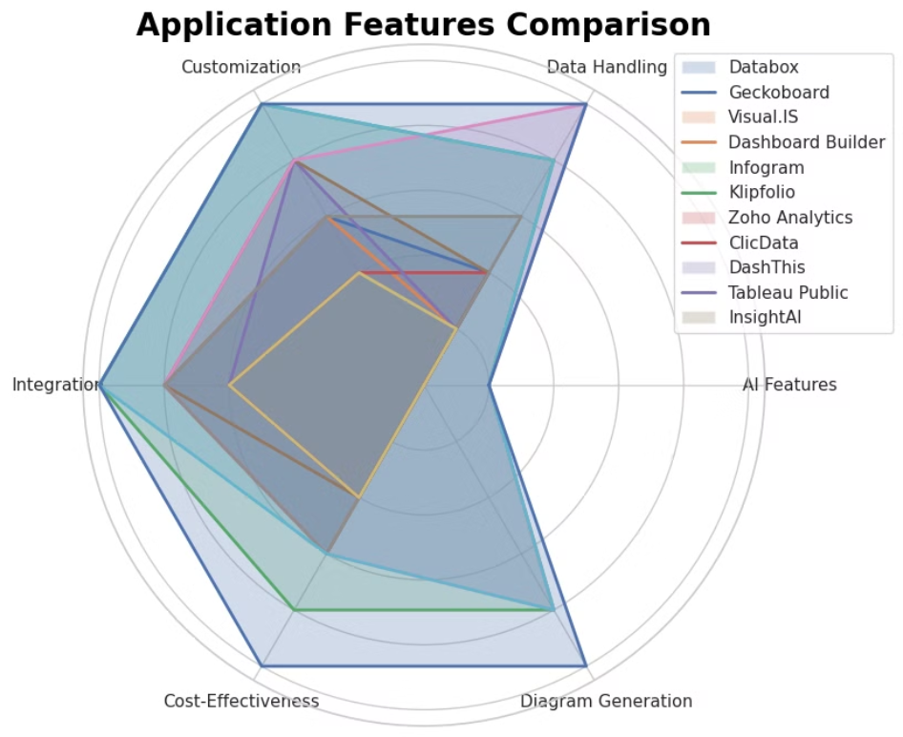

Slide 10




System Overview
Web Application
User-friendly interface with customizable themes.
Data Processing
Combining Manual methods with AI-powered analysis techniques.
Visualization Engine
Interactive tools for creating charts and diagrams.
AI Assistant
Engage with AI for Advanced Data Insights

Slide 11
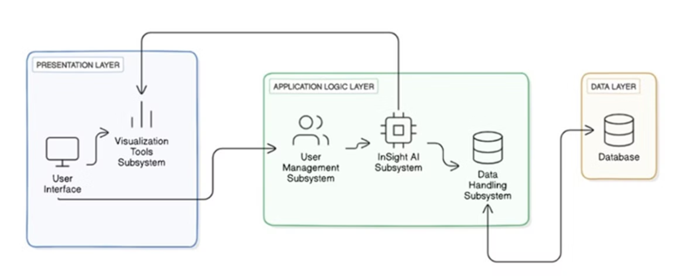
High Level System Architecture

Slide 12
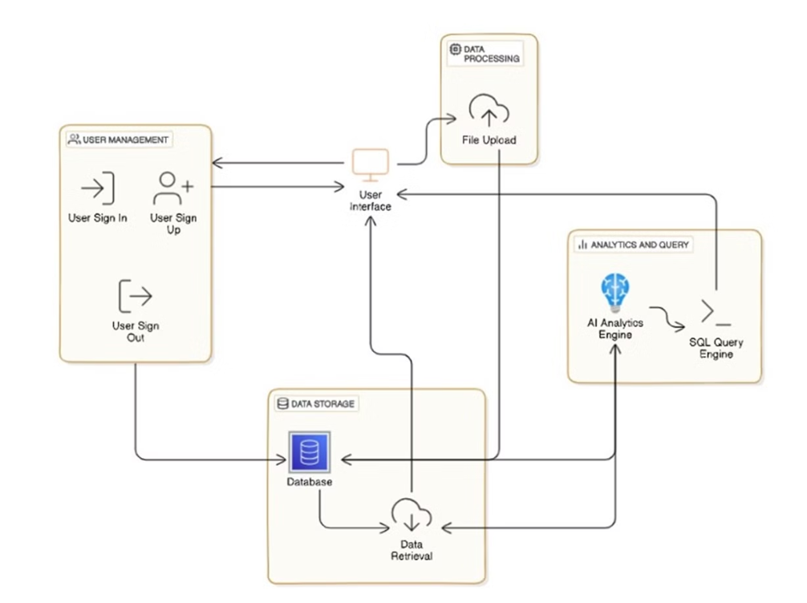
User Management Subsystem

Slide 13
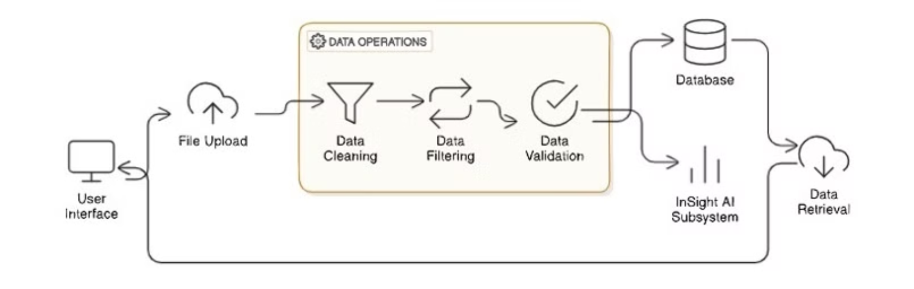
Data Handling Subsystem

Slide 14
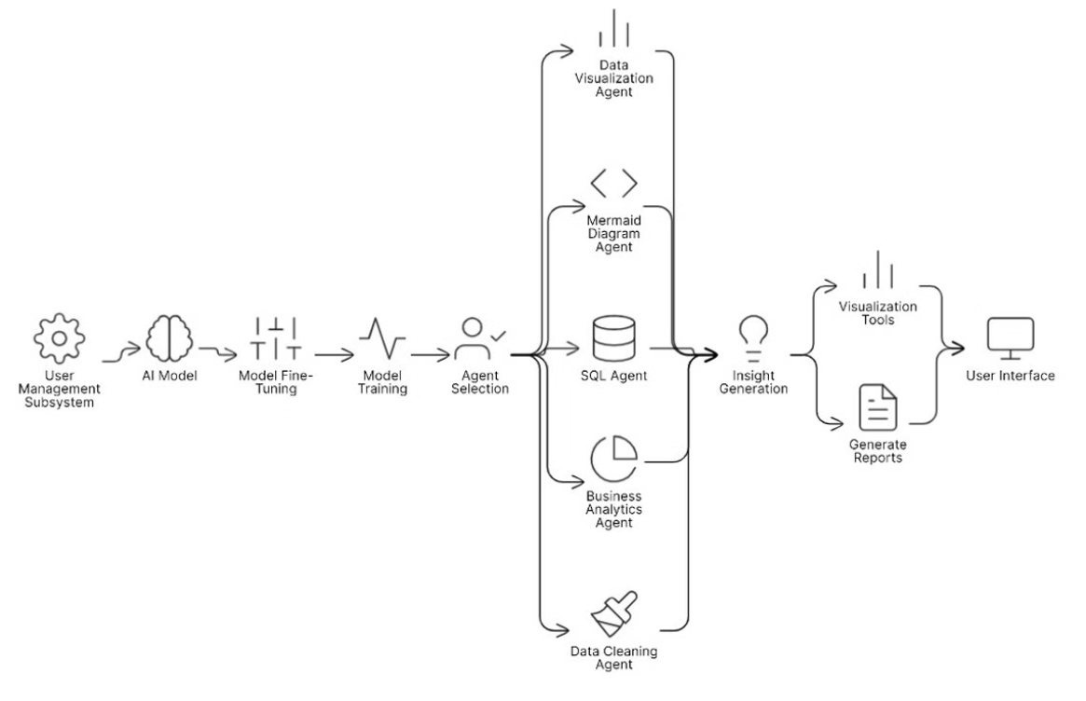
InsightAI Engine Subsystem

Slide 15
Important Requirements
Functional requirements
Non-functional requirements
User Registration and Login
Guarantee reliability and uptime.
Support various data formats.
Ensure Data Security
Data Analysis with AI and manual techniques.
Scalability for Large Datasets and User Growth
Data Visualization
User-Friendly Interface for All Users
Report Generation
Cross-Platform Compatibility
Customized Dashboards
Performance Optimization

Slide 16
Graphical User Interface

Slide 17

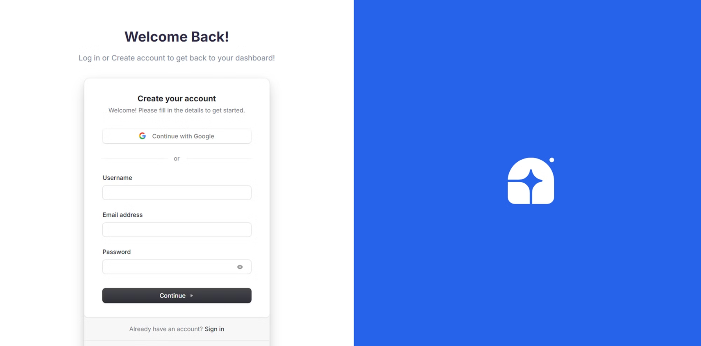
Welcome

Slide 18

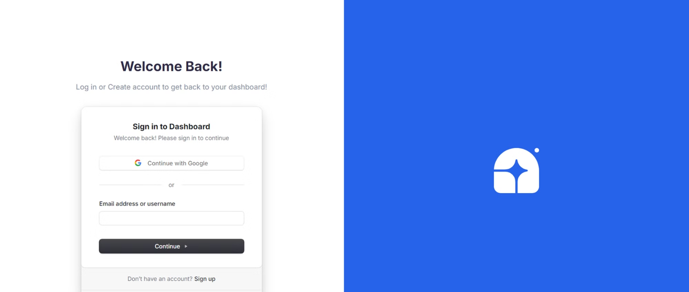
Welcome

Slide 19
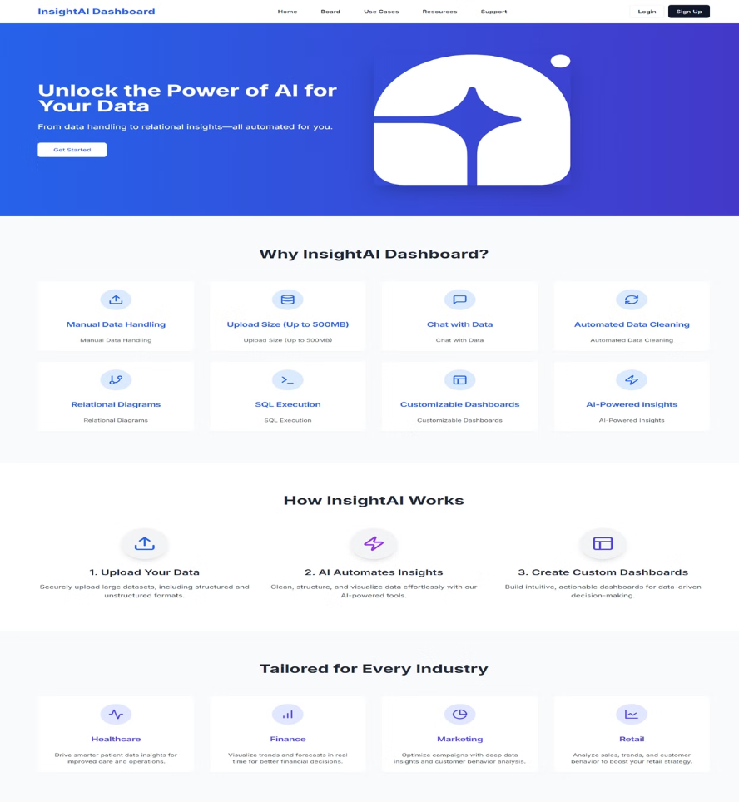

Slide 20

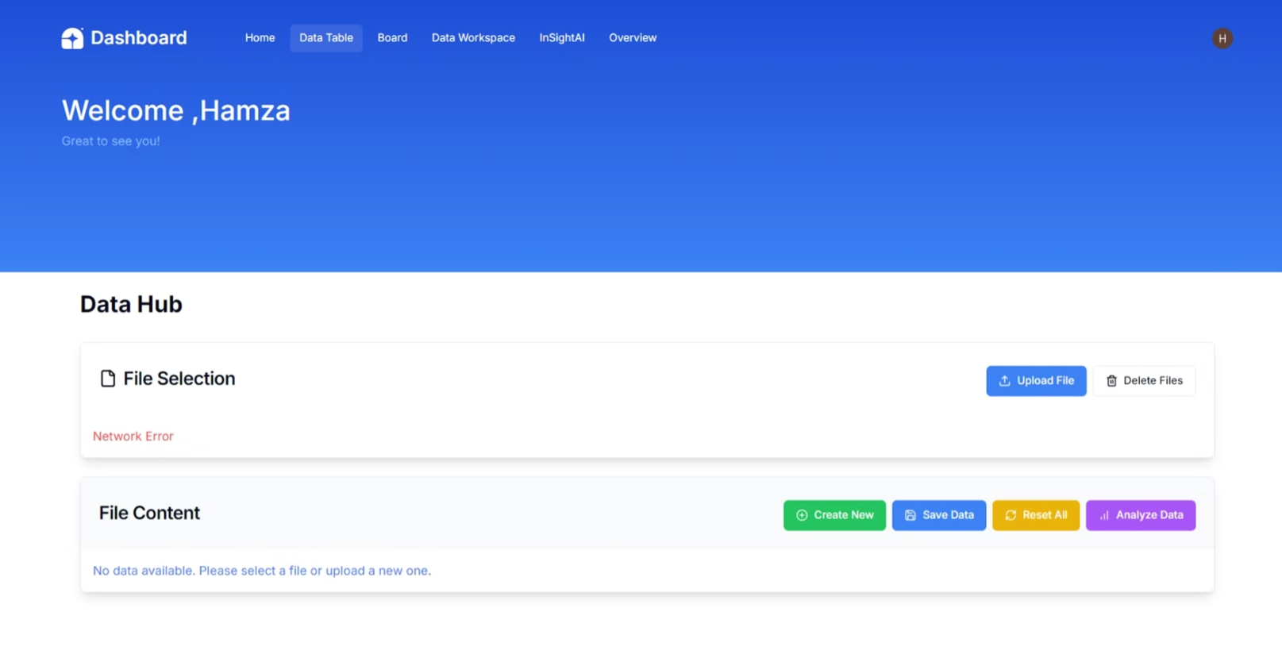

Slide 21

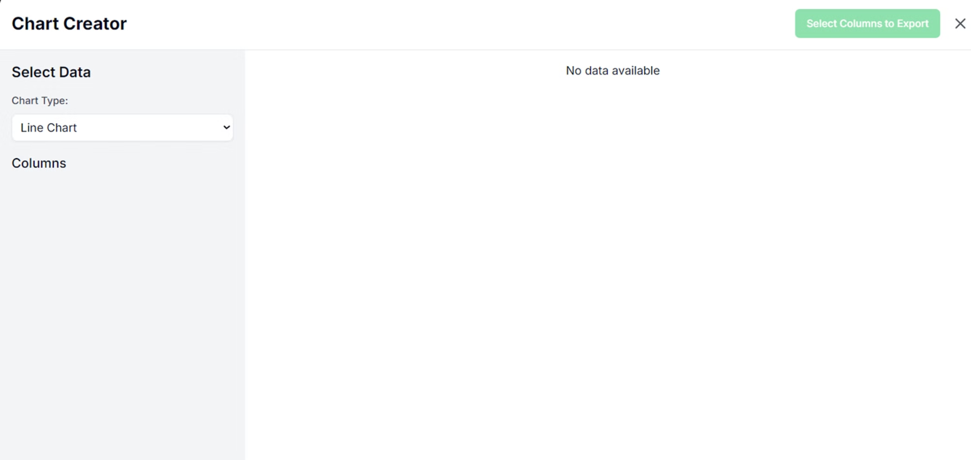

Slide 22

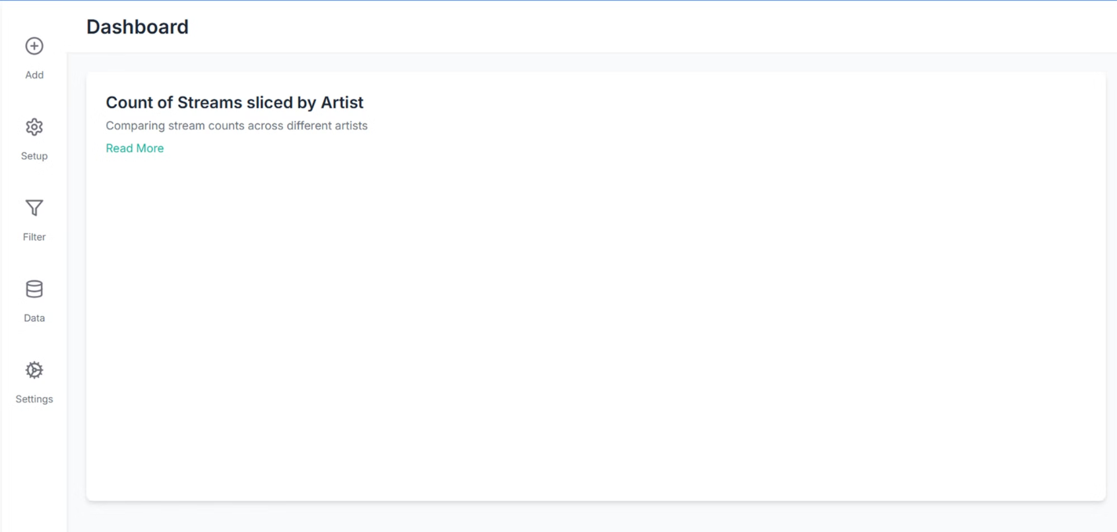

Slide 23
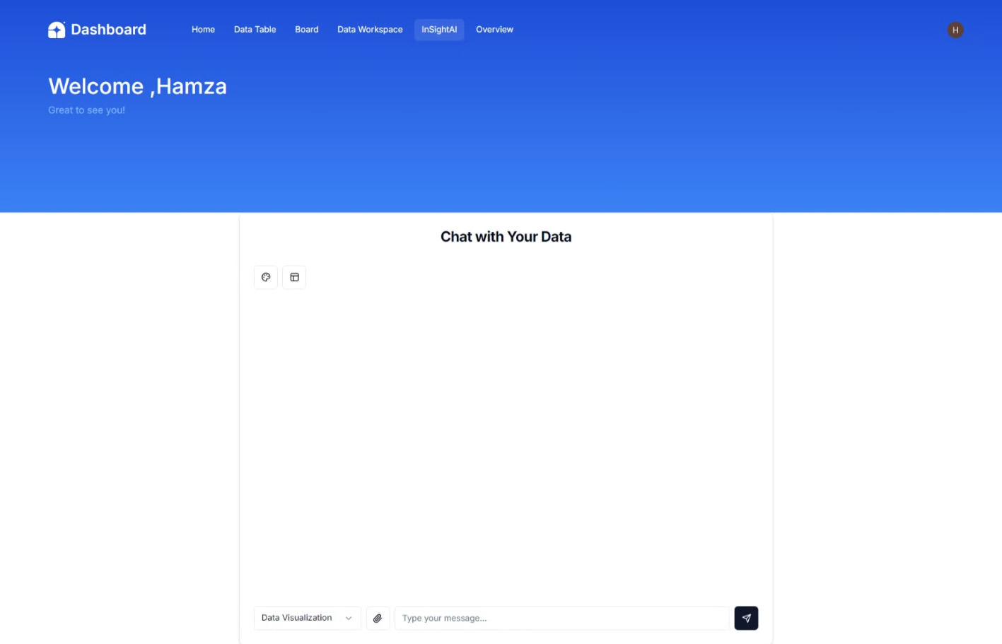

Slide 24
Constraints and Limitations
1
Data Size
2
Complex Queries
Limited processing for extremely large datasets.
Performance issues with highly complex SQL queries.
3
AI Accuracy
4
Connectivity
Potential for errors in AI-generated responses.
Dependency on internet connection for full functionality.

Slide 25

Timeline

Slide 26
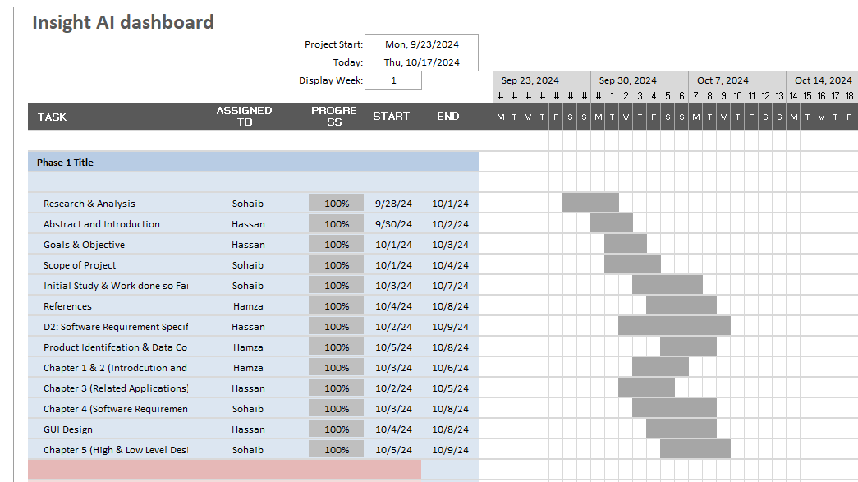

Slide 27
Future Goals
1
Responsiveness
Support for the application across all platforms (mobile/desktop devices)
2
AI training
Implementation of the fine tuned/hosted AI model
3
Error Handling
Ability to handle errors in the applications for test cases.
4
Implementation for basic features
Development of the basic implementation for the applications

Slide 28
Conclusion: Transforming Data Analysis
Innovation
Empowerment
Future-Ready
Bridging gap between complex data and user-friendly analysis.
Enabling all users to gain valuable data insights.
Positioned for growth with AI and visualization capabilities.

